Slide 1



Analysis of Product Performance and Sales Trends in Amazon
Presented by: Hemanth Kumar Reddy Makireddy
B.Tech (CSE - Data Science and ML)
K22UN
12200237
Roll no: 65

Slide 2
Table of Contents
Problem Statement
Solution Approach & Abstract
Methodology
Results
Analysis
Conclusion
References

Slide 3
Problem Statement
Online shopping platforms like Amazon attract diverse customer groups with distinct behaviors and preferences.
However, understanding these behaviors is challenging due to:
The dynamic nature of customer needs.
Differences in product categories, pricing, and delivery experiences across platforms.
This analysis aims to:
Enhance customer satisfaction through data-driven insights.
Improve retention strategies and profitability for businesses.

Slide 4
Solution Approach & Abstract
Solution Approach:
Analyze historical data to identify patterns and trends.
Use machine learning techniques for segmentation.
Abstract:
Dataset includes categories like 'Order ID,' 'Date,' 'Amount,' etc.
Analysis involves PCA, K-Means clustering, and visualization techniques.

Slide 5
Methodology
1. Data Preprocessing:
Data Cleaning:
Handled missing values (mean/median for numerical, mode for categorical).
Standardized column naming conventions in 'Status' and 'Fulfillment.'
Outlier Detection:
Applied IQR method to identify and cap outliers in 'Amount' and 'Quantity.'
2. Feature Engineering:
Added Fulfillment_Type to categorize orders into "Easy Ship" and "Other."
Defined Sales_Success as a binary target variable:
Success: "Shipped" or "Delivered" = 1
Failure: "Cancelled" or "Returned" = 0

Slide 6
Methodology
3. Feature Scaling:
Standardized numerical features like 'Amount' and 'Quantity' using StandardScaler for consistency in analyses.
4. Exploratory Data Analysis (EDA):
Univariate Analysis:
Visualized numerical distributions with histograms, KDE plots, and violin plots.
Count plots highlighted category-wise sales trends.
Bivariate Analysis:
Explored relationships between sales, quantity, and categories using line plots and hexbin plots.
Correlation heatmaps identified feature relationships.
5. Dimensionality Reduction (PCA):
Reduced dimensionality and visualized key components to identify patterns.
Used PCA-transformed features for clustering and analysis.

Slide 7
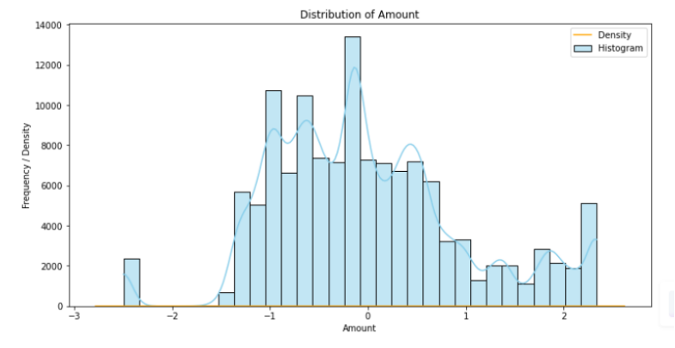
Results and Analysis
HISTOGRAM

Slide 8
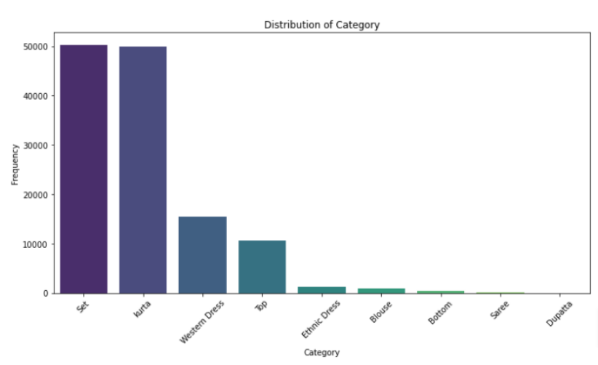
Results and Analysis
COUNT PLOT

Slide 9
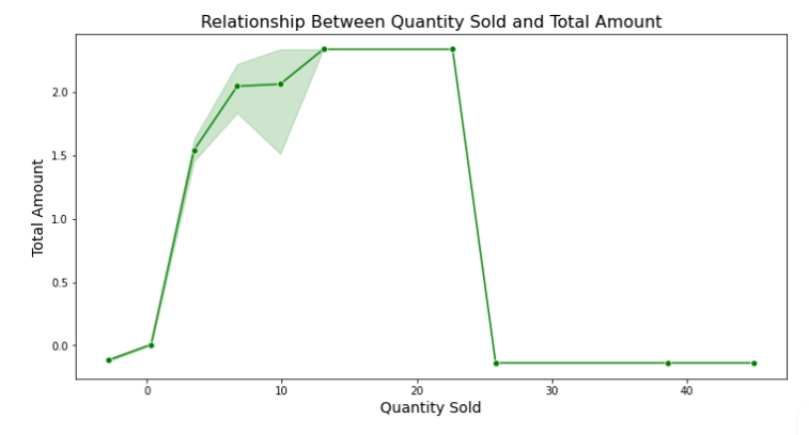
Results and Analysis
LINE PLOT

Slide 10
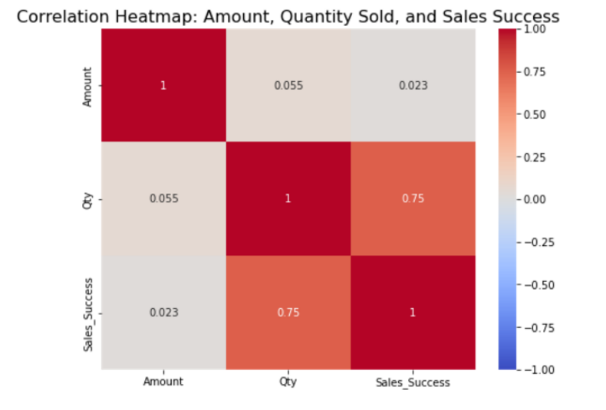
Results and Analysis
HEAT MAP

Slide 11
Results and Analysis
Sales Amount Distribution:
The distribution of amounts is roughly normal with some skewness and multiple peaks, indicating different customer segments or transaction types.
Outliers at both ends suggest potential anomalies or special cases that need investigation.
Quantity Distribution:
The quantity distribution is heavily skewed, with most transactions involving low quantities and a few high-quantity outliers.
High-quantity transactions may indicate anomalies, bulk orders, or special cases requiring further exploration.
Order Status Insights:
The majority of orders are marked as "Shipped," showing efficient order fulfillment.
Cancellations are relatively frequent, suggesting possible issues with customer satisfaction, stock availability, or system errors.

Slide 12
Results and Analysis
Product Category Insights:
Categories like Saree and Kurta dominate the dataset, indicating a strong preference for traditional clothing.
Underperforming categories, such as Dupatta and Scarf, might need further analysis to understand demand or supply chain issues.
Quantity vs Total Amount Relationship:
There is a non-linear relationship between quantity sold and total amount, with the highest revenue occurring at certain quantity thresholds.
Beyond a certain point, increasing the quantity sold does not significantly affect the total amount, possibly indicating pricing or volume caps.

Slide 13
Results and Analysis
Sales Success and Quantity Correlation:
A strong correlation exists between Quantity Sold and Sales Success, highlighting the importance of selling higher volumes for successful transactions.
The weak correlation between Amount and Sales Success suggests that pricing strategies or promotions play a bigger role in determining success than the total sale amount.
Multivariate Analysis:
The combination of Amount and Quantity Sold is crucial in predicting sales success.
PCA analysis reveals that the majority of the variance in sales data is driven by these two variables, simplifying the dataset for better decision-making.

Slide 14
Conclusion
Sales Success: The quantity sold is strongly linked to sales success, while total sales amount has a weaker impact.
Product Categories: Traditional categories like Sarees and Kurtas dominate, with potential for growth in Western attire.
Operational Efficiency: A high percentage of orders are shipped, but cancellations remain a concern, indicating room for process improvement.
Data Distribution: Skewed distribution in Quantity and Amount suggests that addressing outliers could improve data quality.
Customer Insights: Optimizing fulfillment and offering targeted promotions could enhance customer satisfaction and boost sales.

Slide 15
References
Amazon Dataset for Data Analysis
Kaggle: Amazon Sales Dataset. https://www.kaggle.com/ .
Online Documentation and Tutorials
Towards Data Science Blog: https://towardsdatascience.com/
GeeksforGeeks: Python and Data Science Tutorials. https://www.geeksforgeeks.org/

Slide 16



Thankyou

